Slide 1

February 23, 2023
Online EdD or EdS
Marianne Schmeling, MA
Notes:
*Note: Share sound when sharing screen*
PASTE IN TO CHAT WHEN SESSION IS LIVE
​
START SESSION: Record Meeting and Start Script
SLIDE 1
FIELD: Hello, everyone! I’d like to welcome you to our ACE Online Doctoral Lunch and Learn Thank you for joining us. ​We are looking forward to providing more information on American College of Education and the benefits you have with UKHealth. ​
Before we begin, there are a few logistics to go over. You’re in listen-only mode to preserve the sound quality of our session. You may use the Q&A box to enter questions at any time, and I’ll address them at the end of the presentation. Additionally, we are recording this session, and we’ll send you a link to the recording about 24 hours from now. ​ ​
Now, I’d like to introduce you to your hosts

Slide 2
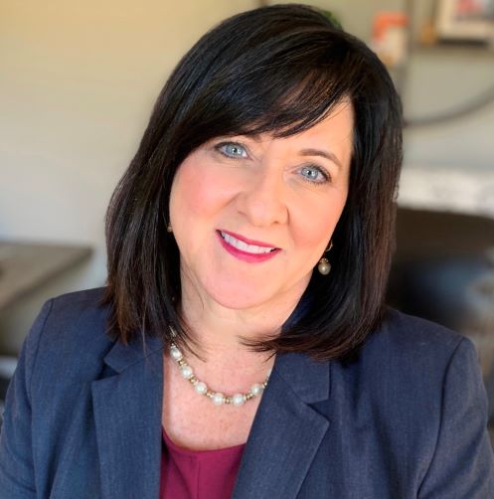


Marianne Schmeling
Asst. Vice President Field Operations & Partnerships- Healthcare
Marianne.Schmeling@ace.edu
614-774-1757
Sigma Theta Tau Corporate Board Member
Nursing Education 10 years
Former Mental Health Therapist
Medical Device Sales
Notes:
FIELD: Introduce yourself and any co-presenters.

Slide 3

What we'll cover
The ACE difference
Tuition and payment options
Programs and academic pathways
Upcoming term starts
Q&A
Notes:
FIELD: I have a brief information session planned - where I’ll introduce you to American College of Education! I’ll share what sets ACE apart from other higher education institutions. We will also go over UKHealthcare’s tuition and payment program. And I’ll close by reviewing our upcoming term start opportunities and giving you a chance to ask any questions you might have.

Slide 4





Since receiving our accreditation in 2005, we have delivered the most affordable and highest quality programs available.
2005
Founded and accredited
2009
Moves fully online
2013-2018
Expands into nursing, healthcare, business
2016
Becomes a Certified B Corporation
2020
ACE receives CCNE accreditation for its RN to BSN, BSN to MSN, and RN to MSN programs.
Notes:
FIELD: American College of Education, or ACE, was founded in 2005 and since then, we have helped many working professionals advance their careers through some of the most affordable and highest quality programs out there. As part of our mission to support more professionals in service-oriented fields, we expanded into healthcare, nursing and business starting in 2013. We were very excited to earn CCNE-accreditation in 2020 and we’re still continuing to grow in these fields, with plans to offer more programs every year.
ACE also sets itself apart by being a Certified B Corporation. This is a designation given to companies and organizations who use the business as a force for good. We uphold strict standards to minimize environmental impact, give back to the community and make responsible financial decisions so we can maintain our low tuition. For us, a huge part of being a B Corporation is ensuring we always put our students first and our students definitely feel the difference.
American College of Education is proudly accredited, Higher Learning Commission EdD EdS and CCNE ( RNBSN BSNMSN RNMSN )

Slide 5
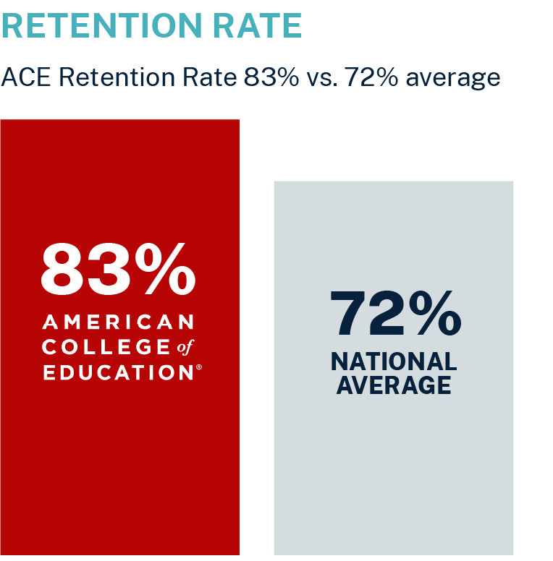

The ACE difference
90%
of students found our courses intellectually challenging.*
84%
of students in our programs found the faculty a great resource for knowledge and learning.*
Tuition is nearly 60% less
than other online colleges
37,000+ alumni
Source: www.ace.edu/about/student-right-to-know
*From 2019 Health and Wellness course feedback surveys
Notes:
FIELD: Rankings aside, I want to drill down into the high educational quality you can expect from our programs or what I like to call the ACE difference. First of all, we have an 83% student retention rate, which is well above the national average and something we’re extremely proud of. We were named the #2 online college in America in 2023 by Newsweek. To get their rankings, Newsweek surveyed 9,000 people who had recently participated in an online program and we're so happy to see such a high satisfaction rate with the educational experience we provide. It also corresponds to the fact that 90% of our students found our courses intellectually challenging and 84% of students found that our faculty were a great resource. And when you do graduate at ACE, you immediately join an alumni network of over 37,000 graduates, so you have access to a substantial web of professional connections.

Slide 6


Accomplished faculty
Learn from award-winning faculty, who share strategies grounded in real-world experience.
All core faculty have doctoral degrees and are practitioners in their field.
Dr. Kimya Nance
Core Faculty, Nursing
DAISY Award for Extraordinary Faculty Member, 2022
Notes:
FIELD: At ACE, you get access to the best and brightest faculty across the nation. These are leaders in their fields who are eager to share their wisdom, advice and knowledge gained from their years of advanced research, study and hands-on experience. Our faculty have served on state boards and committees, advisory councils and as deans. They have worked in medical-surgical units, home care, intensive care and in nurse leadership. Time and again, something we hear from our students is that they love how connected our faculty are to the day-to-day work our students are doing every day. It’s clear to them how grounded and in-tune our faculty are to today’s healthcare landscape, and it makes the strategies they share that much more applicable and practical. An example of one of our great faculty members is Dr. Kimya Nance, one of our nursing core faculty members, who also received a DAISY Award for Extraordinary Faculty Member last year.

Slide 7

What you can expect along the way
Fully online coursework
Consistent course structure
A wealth of digital student resources
Notes:
UKHealth FIELD: So, let’s talk about what you can expect as an ACE student. Nurses and Healthcare professionals realize early on in their careers that they are life-long learners. Between family, career, taking care of others and yourselves, it is challenging. ACE was created by those who serve to serve others, like you.
FIELD: So, let’s talk about what you can expect as an ACE student. Many of our students, when they start a program with us, are returning to school after quite a bit of time away. Understandably, that can be nerve-wracking, and we recognize that. The level of support we provide our students ensures that, regardless of whether you were last a student yesterday or 10 years ago, you’ll find success.
First of all, your coursework will be fully online and you can take it with you wherever you go. Something our students also love is the consistent structure of our courses, regardless of who your instructor is. That allows you to plan ahead. For example, if you know there will always be a paper due at the end of week three and a major exam at the end of week five, you’ll have ample time to incorporate that into your schedule. Most of our doctoral-level courses are ten weeks long and you usually take them one at a time. You can also customize our programs so they fit your professional focus by picking a portion of your courses to fit what you’re most interested in, what we call focuses of study. We want your coursework to be as applicable as possible to the work you want to do or the field you want to explore.
And finally, we offer a full host of digital resources to help you successfully complete your coursework, including a robust writing center full of tips and guides for how to write effective academic papers and a career services center. Every (semester), you get seven free hours of tutoring from Tutor.com if you need it. And you have full access to our expansive digital ACE Library, where you can find thousands of periodicals, academic journals, papers and anything else you might need to further your study. Along with that, we have two friendly and fantastic librarians who are always standing by to help students find what they need so you’ll never feel lost.
And this is really just the tip of the iceberg. There’s a whole litany of digital tools and platforms our students have access to that just can’t fit on a slide. And the best part is you retain access to many of those tools and resources even after you graduate as an alumni, so you’re getting even more value out of your time at ACE.

Slide 8
Quality education you can afford
While other institutions are raising tuition, we've kept our tuition steady. Our low costs are a demonstration of our commitment to being a solution to the student debt crisis, not a contributor.
Bachelor’s-completion under
Master’s under*
Doctorate under
$9,510
$9,500
$24,000
*Exceptions apply.
Notes:
UKHealth: Today I am going to talk about the Doctorate under $24,0000 total cost of your program, inclusive of technology and library fees. We believe that full transparency is the best policy when it comes to cost, so if you want to know the cost of a specific program, all you need to do is ask and we won’t hesitate to let you know. Sue Strup will be sharing here soon in the slides coming up how UKHealth tuition program.

Slide 9
Options to fit your budget
Pay out of pocket
Pay as you go
Third-party financial support
Cover your entire program in one payment
Pay one course at a time
Options include monthly payments and other loans
Notes:
FIELD: Since we’re talking about tuition, let’s talk about our payment options. We offer many payment options including paying out of pocket, either in-full or course by course. Because our programs are so affordable, many of our students are able to choose this option. However, we’ve also work with many third-party lenders such as Sallie Mae, Climb Credit, Ascent and TuitionFlex to give you access to a plethora of options that will work with your budget. You are also free to obtain financing from any provider of your choice.
It’s worth noting that ACE doesn’t accept federal funding or FAFSA. This is a key reason behind why we’re able to keep our costs consistently low. By not accepting federal funding, we maintain full control over our tuition costs and can keep them aligned to only how much it takes to run our programs and nothing more.
However, students who are enrolled in our degree programs are eligible to submit for federal loan deferment. Our enrollment counselors are happy to discuss what the right plan for you might be.

Slide 10
What’s best for your career?
Ed.D. Programs
Ed.S. Programs
$23,914
36 months
64 credits
Master’s degree or higher
Guided dissertation
$12,184
21 months
34 credits
Master’s degree or higher
No dissertation required
This is an estimated value of the cost for tuition and fees.
Notes:
FIELD: So, let’s dive a little more into our doctoral-level programs.
We offer both doctoral, or Ed.D., and education specialist, or Ed.S., programs at the doctoral level. They both allow you to engage in scholarly practice at the doctoral-level but the Ed.D. is what results in a doctorate. Our Ed.D. programs take only about three years to complete, and you may feel like that’s a shockingly short amount of time for a doctorate. But the reason why is because the dissertation process is included as part of the program. When you reach that stage, your courses are designed to guide you through every step of the dissertation, from proposal to approval to the writing to the review. You’ll have a committee of individuals dedicated to helping you find success all the way through your dissertation defense.
However, we recognize that not everyone is necessarily ready to take on a dissertation right away. The Ed.S. program is a perfect alternative. It’s shorter, it costs less, you can still engage in a deep level of study and research, and you can complete the program without having to write a dissertation. But perhaps the best part is that after you’ve completed an Ed.S., you can come back when you’re ready to earn your Ed.D. and you’ll have already done the vast majority of what you need to do for the doctorate. We have an All But Dissertation pathway that allows you to transfer into your Ed.D. the Ed.S. coursework you’ve already completed so you only need to focus on the last piece you need, the dissertation. Your Ed.S. will cost a lot less, you’ll finish it a lot faster but the most important part is that it allows you to tackle your doctorate when you are truly ready, knowing that you’ve already done a lot of the work you need to do to get there.
The EdD in Nursing Education is specifically for those individuals who want to be leaders in nursing education. The EdD is fundamentally a practitioner’s degree, intended for working professionals interested in taking on leadership roles in both academic/educational and organizational settings.

Slide 11
DOCTORATE IN
Nursing Education
Our fully online program prepares you to educate the next generation of nurses in either an academic or professional development setting.
Focus of study options
Total program cost*
Curriculum and Instruction
Health and Wellness
Higher Education
Instructional Technology
Leadership
$23,914
64 credits | 36 months to completion
*This is an estimated value of the cost for tuition and fees.
Notes:
FIELD: We know there is a great need for professional nurse educators. ACE is working hard to provide a solutions to the nursing and healthcare workforce shortage. By offering a Doctoral option in nursing education, with quality, focus of study choices and affordability we can help make a difference. When you choose the educational pathway of the EdD, with the focus of nursing education. Prepares one to be an Educational Leader in an organization. Conducting research in areas of nursing education and how to improve it. EdD does not have clinical hours. The Doctoral dissertation gives back to the future of a nursing/healthcare organization.

Slide 12

DOCTORATE IN
Public Health Education
Fully online
Focus of study options available
Develop the competencies necessary to address public health issues in local, national and international communities
Total program cost*
$23,914
64 credits | 36 months to completion
*This is an estimated value of the cost for tuition and fees.
Take a major step forward in your career.
Notes:
Field: The EdD prepares scholar-practitioners to solve problems in their places of employment by utilizing advanced knowledge of the latest evidence-based practices and pedagogical systems. In addition, students learn how to employ quantitative and qualitative research methodologies to identifying, examining, and developing viable solutions to problems in education.

Slide 13
Admission requirements
Nursing Degrees
Master’s
Doctorate
Academic requirements vary
Minimum GPA 2.50*
Bachelor’s or highest post-baccalaureate degree earned
Minimum GPA 2.50*
Master's or doctoral degree earned
Minimum GPA of 3.00
Complementary transcript evaluation | Send official transcripts | No GRE required
*Exceptions apply.
Notes:
FIELD: One of the most common questions we get asked is about admission requirements, so I wanted to talk about it here. What you see on your screen are our general requirements for each degree level, but some programs have additional or specific requirements so I recommend you connect with an enrollment counselor to get more detailed information once you’ve decided the program you want to pursue. For example, when you apply to a doctoral program, you’ll be asked to submit a goal statement and a recorded interview. However, we do not require a GRE for any program.
The academic requirements for our nursing degrees also vary depending on the program. Once you know the degree you’re interested in, I highly recommend reaching out to one of our enrollment counselors to get specific admission requirements for that degree.
Our application process is quick and painless. For most programs, the most involved documentation you’ll need to send in will be your official transcripts from previous institutions. Your enrollment counselor will let you know if any other additional documentation is needed.

Slide 14
Ed.D. in Nursing Education career positions:
Nursing Professor or Nurse Educator
Director of Nursing |Director of Education
Director of Undergraduate Nursing
Director of Graduate Education
Clinical Nursing Instructor
Chief Nursing Officer
Policy Maker
Director of Nursing Professional Development
Continuing Education Director
Epic System Educator | Trainer
RN Education Specialist
Clinical Nurse Consultant
Chief Learning Officer
Education Administrator
Training and Development Manager
Career Positions
Notes:
Recent career positions:
Careers: Graduates of Ed.D. programs with a focus in health care leadership or health care education can step into roles such as healthcare administrator, professor of nursing, behavioral health program administrator, and more.
For example: College or University Dean, Professor of Nursing, Healthcare Administrator, Behavioral Health Program Administrator,
Ed. D. in Nursing Education Jobs
Nursing Professor.
Nurse Educator.
Director of Nursing. Hospitals/Medical Centers/Academic Institutions/Administrative Roles
Director of Nursing Education.
Director of Undergraduate Nursing.
Director of Graduate Nursing Education.
Clinical Nursing Instructor.
Chief Nursing Officer (CNO)
policy maker.
curriculum director.
chief learning officer.
education administrator.
Training and development manager.
Job titles in health care include:
Clinical Nurse Preceptor
Clinical Nursing Consultant
Clinical Practice and Education Specialist
Director of Nursing Professional Development
Continuing Education Coordinator
RN Education Specialist

Slide 15

Ready to get started?
Submit an application today!
TERM START
April 10
DEADLINE April 7
TERM START
May 22
DEADLINE May 19
TERM START
July 10
DEADLINE July 7
Rolling start dates give you flexibility to start when you want
Notes:
FIELD: So, if you are ready to apply, we are ready for you! Here I’ve listed some of our upcoming deadlines and term starts. ACE operates on rolling start dates. We generally have a new term start every six weeks or so, with a few exceptions here and there, but some of our programs aren’t offered every term. If you know the general time in which you want to start a program, let your enrollment counselor know. We’ll be able to advise you on what term you should target based on program availability and your preferred timeline.
While the deadlines for applications are listed as the Friday before the start date, please keep in mind it takes around 72 hours for processing of various Ed.D. and Ed.S. required documents. If you’re interested in our doctoral-level programs, we recommend you get your application and all your documents in no later than the Wednesday before the official deadline.
We also highly recommend you apply and submit all required items as soon as you decide ACE is the right fit for you, even if start date you applied for is still a while out. A huge benefit of being enrolled early is having full access to new student orientation, allowing you to prepare early and be ready to dive in once your first course begins.

Slide 16
Scholarship & Grant Information
You can receive part of the more than $2.5M in grants and scholarships we award each year on top of our already affordable tuition. Our mission is to provide high-quality education at an affordable price, and we offer scholarships and grants to meet your needs.
https://ace.edu/tuition-and-admissions/grants-scholarships/
Notes:
https://ace.edu/tuition-and-admissions/grants-scholarships/

Slide 17
UKHealthcare Information

Slide 18

NURSING TUITION CONTRACT
This policy is to provide tuition payment for current licensed nursing employees (RN, LPN) pursuing a nursing degree not offered at UK.
University of Kentucky / UK HealthCare Nursing Policy and Procedure Policy # NU09-29 Title/Description: Tuition Payment for Licensed Nurses Purpose: To provide tuition payment for licensed nurses working within Nursing Services and pursuing an additional degree in Nursing.
https://ukhealthcare.uky.edu/sites/default/files/nu09-29-tuition-payment-for-licensed-nurses.pdf

Slide 19

DO I QUALIFY?
Are you in a current nursing position and have a direct line of reporting to the Chief Nurse Executive?
Must be a current registered or licensed nurse (RN, LPN)
Must be at .50 FTE or higher
On-Call (PRN) status does not qualify
Are you pursuing a nursing degree not offered at UK or were you not accepted into the nursing program offered at UK?
Must first apply to UK if desired program is offered
Have you successfully completed your 90 day orientation period?
Must have successfully completed your 90 day orientation period
Have you received a written corrective action within the last 12 months?
Must not have received a written corrective action or higher within the past 12 months
Have you been accepted into an accredited nursing program?
Nursing program must be accredited by CCNE, ACEN, Higher Learning Commission

Slide 20
FAQ’s
1.
Are you able to take
more than 6
credit
hours a semester?
With the Nursing Tuition Contract Program you can take as many
classes as you like but we only pay for 6 credit hours per traditional semester or up to 18 credit hours per year for non-traditional programs.
.
2.
Are APP’s covered in the Nursing
Tuition Contract?
Yes as long as they meet all other requirements outlined in the
policy.
3.
Do you have to be a bedside RN to utilize this program?
Must be a direct care provider at least 50% of the time or in a leadership
position.
4.
Will the Nursing Tuition Contract cover a MSN, DNP or Ph.D.?
Yes, the policy covers pursuing any nursing degree at an accredited university not offered
at UK such as an MSN in Nurse Practitioner, MSN in Nurse Midwifery, MSN in Nursing Education, etc.
5.
Will the nursing tuition contract payments be considered taxable
income?
No
,
the payment is sent directly to your school and is a
work back
commitment, rather than a benefited program
like EEP
. These
payments are not taxable.
6.
How do you apply for the Nursing Tuition Contract Program?
Please reach out to Andrea Gudenkauf at hospitalpayments@uky.edu and we will be glad to provide you with the appropriate forms.
.

Slide 21
FAQ’s continued
7. How does UK calculate the amount of money that they will pay another school for non-UK nursing programs?
We fund tuition only and pay on a per credit hour basis with a max equivalent to the per hour tuition rate at UK for same degree. It varies school to school, but the current UK rate 22-23 for Health Professionals online is $775.50 per credit hour for a Masters classes and $953 per credit hour for Doctoral classes so we would not pay above those amounts per credit hour. If the school is above that we reduce it to UK rate.
8. If I get accepted to the ACE Ed.D. nursing education program, when should I apply for the Nursing Tuition Contract and how long until I find out if I am approved or not?
As soon as you are accepted into the program you should email us for an application at hospitalpayments@uky.edu. Our review committee meets on the second Tuesday of every month to review pending applications, and typically you will find out within 24 – 48 hours.
9. How is the “work back” commitment calculated and do I have to be working in a job at UK utilizing my new degree?
Workback is 1 month per credit hour funded at a max of 24 months workback. Workback begins upon graduation and as long as you stay in a position with UK nursing services your workback can be fulfilled. If you leave UK before your workback is completed you will have to pay back the portion of funds not worked back.
If I have additional questions re: the Nursing Tuition contract, or need the application to fill out, whom do I contact?
Please reach out to Andrea Gudenkauf at hospitalpayments@uky.edu

Slide 22

Question and Answers with
Bette Bogdan,Ph.D.,MSN,PHN, RB-BC
Department Chair
Question and Answers with
ACE since 2019
Educator and CBE Consultant
Chair Practice & Education Committee New Hampshire Board of Nursing
Multiple Publications
Case Management
Doctor of Philosophy (PhD) Nursing Education and Nursing Administration.
Notes:
Question and Answers with:

Slide 23
Questions?
Notes:
FIELD: Thank you for participating in that. I’d now like to open it up to you all. Feel free to ask any questions you might have!

Slide 24


Interested in learning more?
Reach out to me!
marianne.schmeling@ace.edu
Cell: 614.774.1757
Notes:
FIELD: Thank you again for your time today. If you have any questions, you can always contact me. An enrollment counselor will also be reaching out to you soon to offer their help, so please don’t hesitate to take advantage of that if you have questions about specific programs.

